Slide 1
Chapter 10 Mobile IP

Slide 2
Outline
Addressing
Agents
Three Phases
Inefficiency in Mobile IP

Slide 3
Addressing
Addressing
The main problem that must be solved in mobile communication using the IP protocol
The original IP address was based on the assumption that a host is stationary
Routers use the hierarchical structure of an IP address to route an IP datagram
The address is valid only when it is attached to the network
If the network changes, the address is no longer valid

Slide 4

Note
The IP addresses are designed to work with stationary hosts because part of the address defines the network to which the host is attached.

Slide 5
Mobile Hosts
When a host moves from one network to another
The IP addressing structure needs to be modified
Possible solutions
Changing the address
Two addresses

Slide 6
Changing the Address
The mobile host changes its address as it goes to the new network
For example, DHCP protocol
Drawbacks
The configuration files would need to be changed
Each time the computer moves from one network to another, it must be rebooted
The DNS tables need to be revised so that every other host in the Internet is aware of the change
If the host roams from one network to another during a transmission, the data exchange will be interrupted
Since the port and IP addresses of the client and the server must remain constant for the duration of the connection

Slide 7
Two Addresses
The host has
Its original address, called the home address
Permanent and associate the host to its home network
A temporary address, called the care-of address
Temporary
When a host moves from one network to another, the care-of address changes
Associate the host with the foreign network
A mobile host receives its care-of address during the agent discovery and registration phases

Slide 8
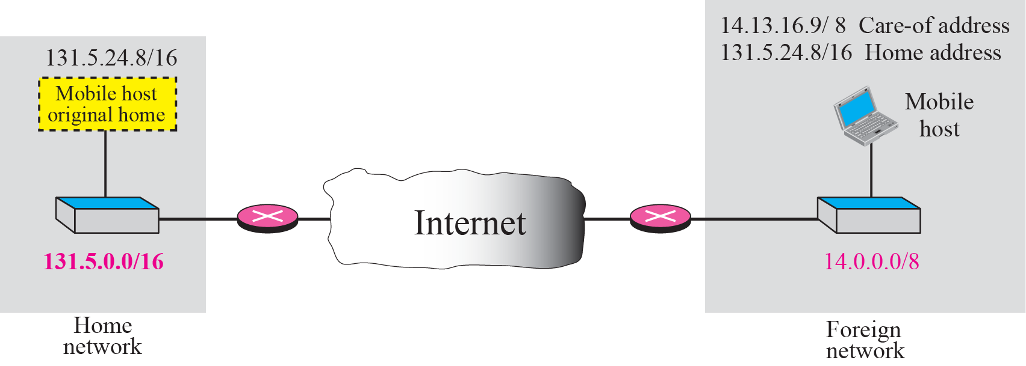
Figure 27-1
Host Address and Care-of Address
The McGraw-Hill Companies, Inc., 2000

Slide 9
Note
Mobile IP has two addresses for a mobile host: one home address and one care-of address. The home address is permanent; the care-of address changes as the
mobile host moves from one network to another.

Slide 10
Outline
Addressing
Agents
Three Phases
Inefficiency in Mobile IP

Slide 11
Agents
To support Mobile IP, there are two agents
Home agent and foreign agent
Home agent
Usually a router attached to the home network of the mobile host
Acts on behalf of the mobile host when a remote host sends a packet to the mobile host
The home agent then sends it to the foreign agent

Slide 12
Agents
Foreign Agent
Usually a router attached to the foreign network
Receive and delivers packets sent by the home agent to the mobile host
A mobile host can also act as a foreign agent
The care-of address is called a colocated care-of address
Advantages:
The mobile host can move to any network without worrying about the availability of a foreign agent
Disadvantages
The mobile host needs extra software to act as its own foreign agent

Slide 13
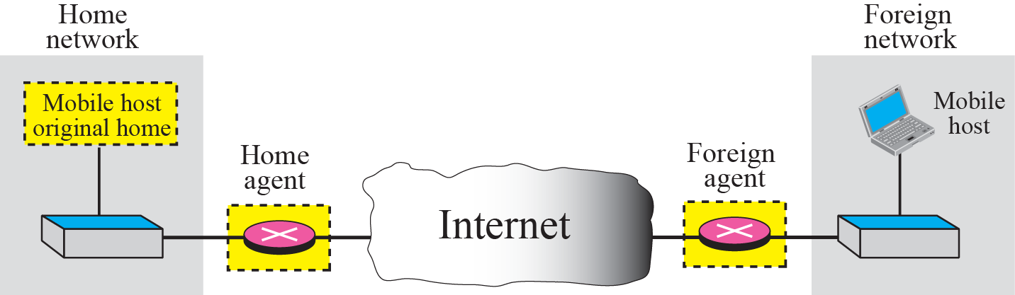
Figure 27-2
Home Agent and Foreign Agent
The McGraw-Hill Companies, Inc., 2000

Slide 14
Outline
Addressing
Agents
Three Phases
Inefficiency in Mobile IP

Slide 15
Three Phases
To communicate with a remote host, a mobile host goes through three phases
Agent discovery
Involve the mobile host, the foreign agent, and the home agent
Registration
Involve the mobile host and two agents
Data transfer
All four entities are involved

Slide 16
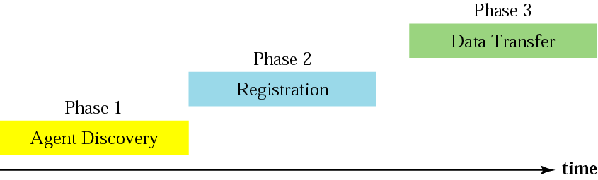
Figure 27-3
Remote Host and Mobile Host Communication
The McGraw-Hill Companies, Inc., 2000

Slide 17

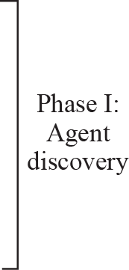
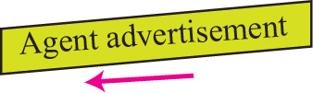


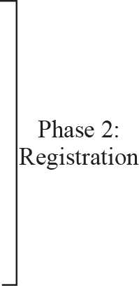





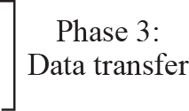

Slide 18
Agent Discovery
Consist of two subphases
A mobile host must discover a home agent before it leaves its home network
A mobile host must also discover a foreign agent after it has moved to a foreign network
The discovery involves two types of messages
Advertisement and solicitation

Slide 19
Agent Advertisement
When a router advertises its presence on a network using an ICMP router advertisement
It can append an agent advertisement to the packet if it acts as an agent

Slide 20
Packet Format of Agent Advertisement
Type: set to 16
Length:8-bit
Define the total length of the extension message
Sequence Number: 16-bit
Hold the message number
Lifttime: 16-bit
Define the number of seconds that the agent will accept the request
Code: 8-bit
See the Table 27.1
Care-of-Address: a list of addresses available for uses as care of address. This field is used only by a foreign agent
The mobile host can choose one of these addresses.
The selection of this care-of address is announced in the registration request message

Slide 21
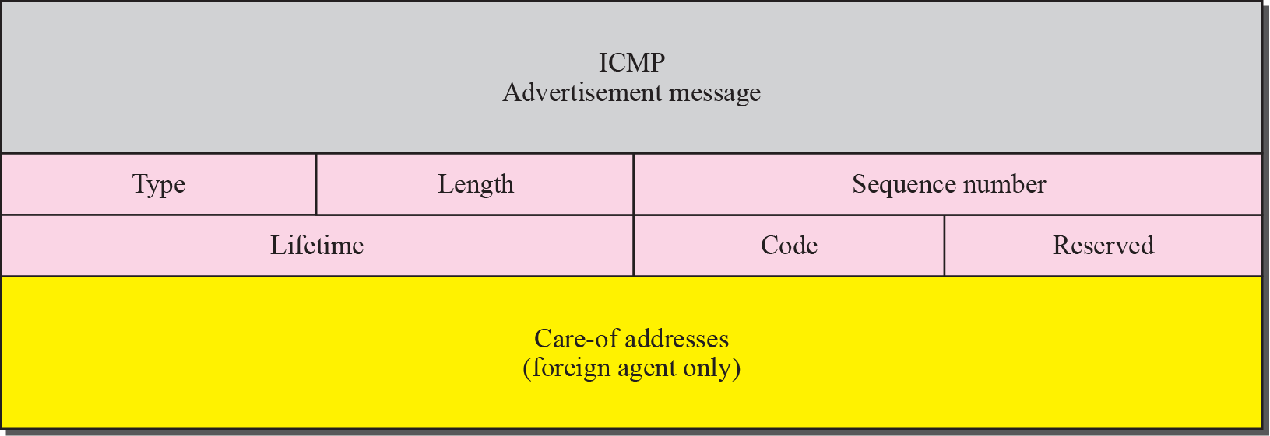
Figure 27-4
Agent Advertisement
The McGraw-Hill Companies, Inc., 2000

Slide 22
Code Bits

Slide 23
Agent Solicitation
When a mobile host has moved to a new network and has not received agent advertisements
It can initiate an agent solicitation

Slide 24
Registration
After a mobile host has moved to a foreign network and discovered the foreign agent, it must register

Slide 25
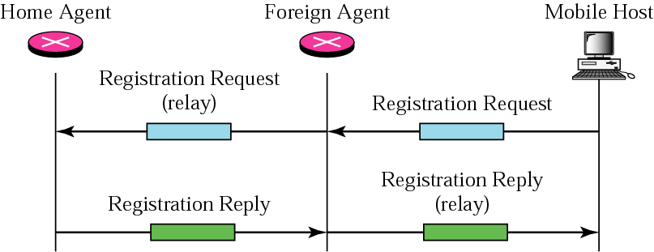
Registration Request and Reply
Registration request and registration reply
To register with the foreign agent and the home agent

Slide 26
Registration Request
Sent from the mobile host to the foreign agent
To register its care-of address
To announce its home address and home agent address
The foreign will then relay the request to the home agent
Home agent now knows the address of the foreign agent
Since the relay packet’s source address is the foreign agent’s IP address

Slide 27
Registration Request Format
Type: 8-bit
Define the type of the message
Flag: 8-bit
Define forwarding information.
The value of each bit can be set or unset. See next two slide
Lifetime: 16-bit
Define the number of seconds the registration is valid
If a string of 0s: the request message is deregistration
If a string of 1s: the lifetime is infinite

Slide 28
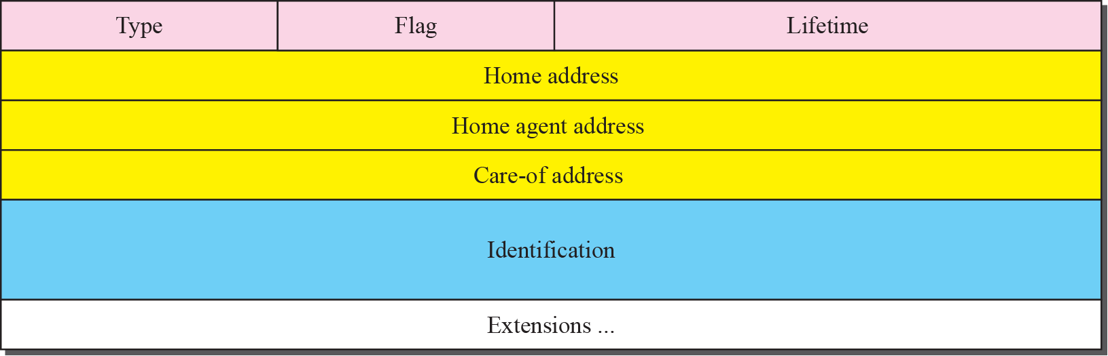
Registration Request Format
The McGraw-Hill Companies, Inc., 2000

Slide 29
Registration Request Flag Field Bits

Slide 30
Registration Request Format (Cont.)
Home address: 32-bit
Contain the permanent address of the mobile host
Home agent address: 32-bit
Contain the address of the home agent
Care-of address: 32-bit
Contain the temporary address of the mobile host
Identification: 64-bit
Inserted into the request by the mobile host and repeated in the reply message
Used to match a request with a reply
Extension:
Variable length extensions are used for authentication

Slide 31
Registration Reply
Sent from the home agent to the foreign agent and then relayed to the mobile host
Used to confirms or denies the registration request
Format: similar to those of the registration request
Code field replaces the flag field
Show the result of the registration request (acceptance or denial)

Slide 32
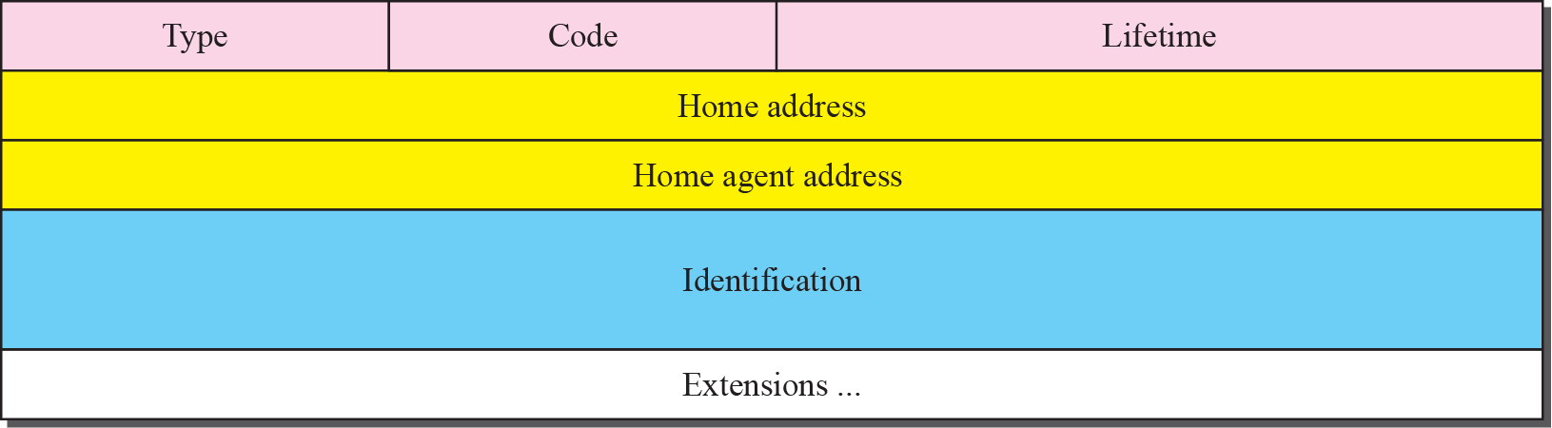
Figure 27-7
Registration Reply Format
The McGraw-Hill Companies, Inc., 2000

Slide 33
Encapsulation
Registration message are encapsulated in a UDP user datagram

Slide 34
Data Transfer
After agent discovery and registration, a mobile host can communicate with a remote host
From remote host to home agent
From home agent to foreign agent
From foreign agent to mobile host
From mobile host to remote host

Slide 35
Figure 27-8
Data Transfer
The McGraw-Hill Companies, Inc., 2000

Slide 36
From Remote Host to Home Agent
A remote host sends a packet to a mobile host
Source address: the address of the remote host
Destination address: the home address of the mobile host
The packet is intercepted by the home agent, which pretends it is the mobile host
Using the proxy ARP discussed in Chapter 7

Slide 37
From Home Agent to Foreign Agent
After receiving the packet, the home agent sends the packet to the foreign agent
Using the tunneling concept
The home agent encapsulates the whole IP packet inside another IP packet
Source address: the home agent’s address
Destination address: the foreign agent’s address

Slide 38
From Foreign Agent to Mobile Host
When the foreign agent receives the packet
It removes the packet header added by tunneling
Then change the home address of the mobile host to its care-of address
Then send the packet to the mobile host

Slide 39
From Mobile Host to Remote Host
When a mobile host wants to send a packet to a remote host
It sends as it does normally
Source address: the mobile host’s home address
Destination address: the remote host’s address

Slide 40
Transparency
The remote host is unaware of any movement by the mobile host
To send packet
Destination address: the home address of the mobile host
To receive packet
Source address: the home address of the mobile host
Thus, the movement is totally transparent

Slide 41
Outline
Addressing
Agents
Three Phases
Inefficiency in Mobile IP

Slide 42
Inefficiency in Mobile IP
Communication involving mobile IP can be inefficient
Double crossing: or 2X
Triangle routing: dog-leg routing

Slide 43
Double Crossing
Occurs when a remote host communicates with a mobile host that has moved to the same network as the remote host
When the mobile host sends a packet to the remote host
There is no efficiency; the communication is local
When the remote host sends a packet to the mobile host
The packet crosses the Internet twice

Slide 44
Figure 27-9
Double Crossing
The McGraw-Hill Companies, Inc., 2000

Slide 45
Triangle Routing
Occurs when the remote host communicates with a mobile host that is not attached to the same network as the remote host
When the mobile host sends a packet to the remote host
There is no efficiency
When the remote host sends a packet to the mobile host
The packet goes from the remote host to the home agent and then to the mobile host
The packet travels the two sides of a triangle

Slide 46
Figure 27-10
Triangle Routing
The McGraw-Hill Companies, Inc., 2000

Slide 47
Solution
The remote host must know the mobile host’s care-of address
Send packet using the mobile host’s care-of address
The home agent can tell the remote host about this information by the update binding packet
However, when the mobile host moves, its care-of address may be changed
The home agent needs to send a warning packet to the remote host to inform it

